Slide 1
Build Secure Enterprise Angular Apps That Leverage Various Microsoft Tech
github.com / andrewconnell / pres-enterprise-ng-mstech

Slide 2






Andrew Connell
www.AndrewConnell.com
me@AndrewConnell.com
@andrewconnell
Full stack web developer & instructor
Co-host, Microsoft Cloud Show – www.MicrosoftCloudShow.com
Hands-On SharePoint Training Critical Path Training - www.CriticalPathTraining.com
On-Demand SharePoint Training Pluralsight – www.Pluralsight.com

Slide 3
Topics
Developer Tools
TypeScript
Securing Applications
Authentication
Authorization
Azure
Active Directory
PaaS
Office 365
Office 365 APIs

Slide 4
Developer Tools

Slide 5
Microsoft Developer Tools
Visual Studio 2013 (2015)
Visual Studio Code

Slide 6
Use Any IDE / Editor
Use of Microsoft tools not required
Anything works…
It’s a new company!
Everything is founded on open standards
Authentication & authorization
Communication
Client over HTTP[S] secured with OAuth 2.0

Slide 7
TypeScript

Slide 8
Why TypeScript?
Superset of JavaScript
Modular
Scalable Application Structure
Strong Typing
Tooling Support
ECMAScript (6) 2015 Standards

Slide 9
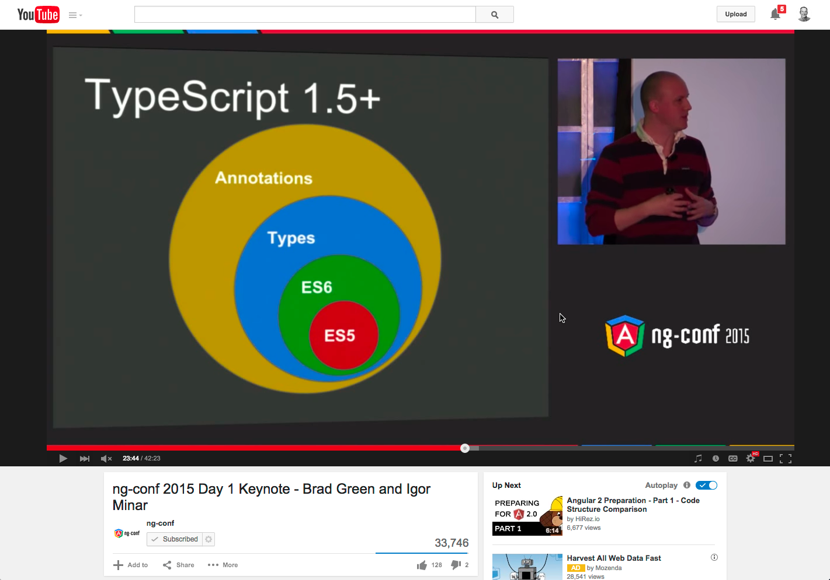
Why TypeScript with Angular?
https://youtu.be/QHulaj5ZxbI?t=20m53s

Slide 10
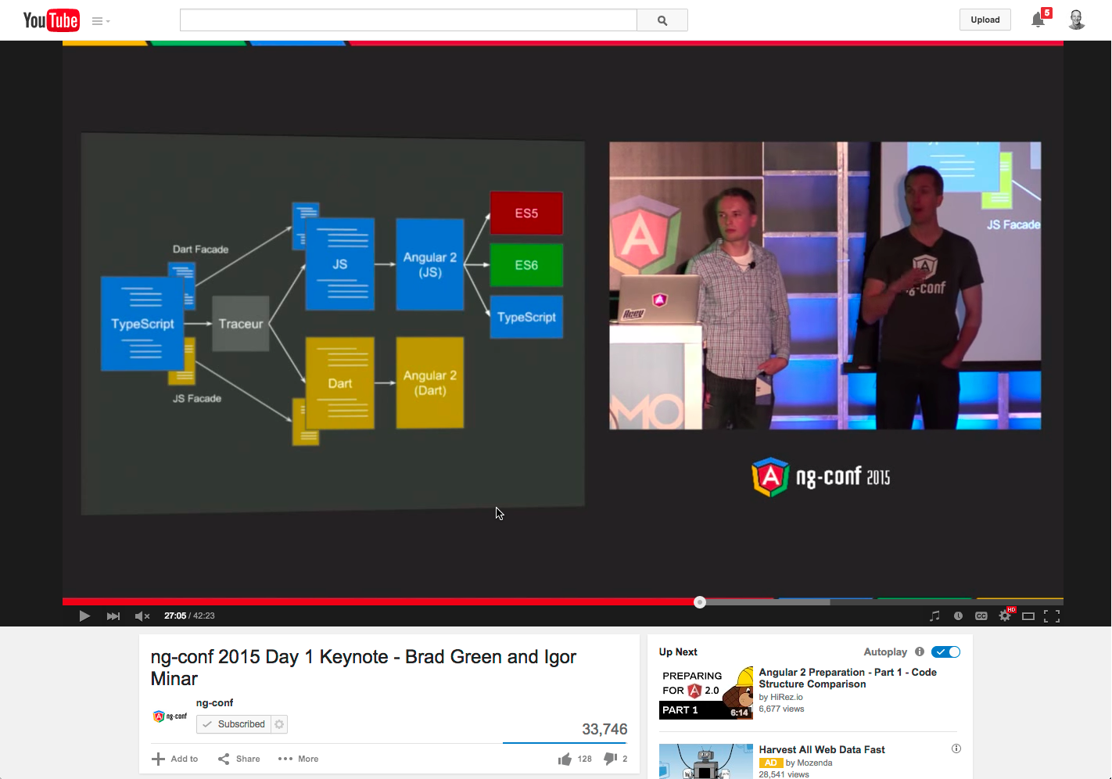
Why TypeScript with Angular?
https://youtu.be/QHulaj5ZxbI?t=27m5s

Slide 11
What is TypeScript?
Strongly Typed
Classes
Interfaces
Generics
Modules
Type Definitions
Compiles to JavaScript
EcmaScript 6 Features

Slide 12
DEMO - TypeScript Playground

Slide 13
How TypeScript

Slide 14
Wide Editor Support
Out-of-the-Box Support
Visual Studio [proper]
Visual Studio Code
WebStorm
Support via add-ins
Sublime Text
Brackets
Anything!
Gulp or Grunt

Slide 15
Angular in TypeScript
Use as little or a much as you like!
Simple
Use 3rd party type definitions
Annotate types
Full buy-in
Use classes
Use interfaces
Use lamda (aka: fat arrow) expressions

Slide 16
DEMO – Angular in TypeScript

Slide 17
Office 365

Slide 18
What is Office 365?
SharePoint Online
Exchange Online
Skype for Business
Yammer
OneDrive for Business

Slide 19
Office 365 Pitch
Fastest growing Microsoft product
80% of Enterprises using Office 365
4 trillion emails
830 million monthly meetings
470PB storage
Contains collaborative data in SharePoint
Contains Exchange data (contacts, calendar & email)
File storage

Slide 20
DEMO – Office 365 Walkthrough

Slide 21
Office 365 APIs

Slide 22
Office 365 for Developers
All data exposed via APIs
Native SDKs (.NET, iOS, Android, Cordova & Xamarin)
REST APIs (based on OData v4.0)
All APIs secured using Azure AD

Slide 23
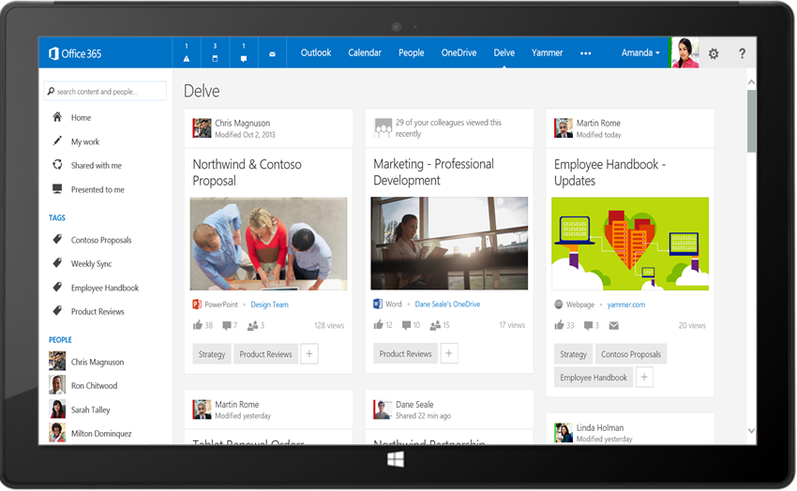
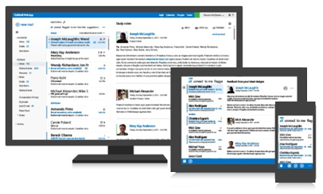




Office 365 APIs
Your App
https://graph.microsoft.com/
USERS
GROUPS
FILES
MAIL
CALENDAR
TASKS
Insights and relationships from Office Graph

Slide 24
OAuth & Authentication Concepts

Slide 25
What is OAuth2
Authentication protocol
Once user is authenticated, they obtain access tokens
Digitally signed string containing claims
Access tokens are the “keys” to secured resources
Secured resources trust the issuer of tokens

Slide 26
Terminology
Access token
Refresh token
OAuth flows
Resource
Issuer
User / application

Slide 27
It all Comes Down to Access Tokens
For the app developer, the goal is to obtain an access token
Valid for a specific period of time
Sometimes acquisition of an access token includes an refresh token
Refresh tokens can be used to update access tokens
This token is passed with each HTTP request to authenticate the user and / or the app
Included in the HTTP request header:
Authorization: Bearer [token]

Slide 28
Obtain Access Tokens with OAuth Flows
Obtain access tokens using different defined “OAuth Flows”
Multiple flows defined in OAuth 2.0 spec
Both the Issuer & Resource must support the flow to use it
Flow Options with Office 365 & Azure AD
Authorization Code Flow
Client Credentials Flow (App only)
Implicit Flow

Slide 29
Flow #1 – Authorization Code
Most common
Very secure - application never gets user’s creds
Flow described:
Web app redirects user to Azure AD to login
Upon successful login, Azure AD redirects user back to web app with an authorization code
Web app uses this code to request access token on behalf of user
Scenarios:
Web applications that use federated logins
User interaction present

Slide 30
Flow #2 – Client Credentials
Very powerful
Requires global tenant admin consent
Not user consent
Flow described:
App configured with the public part of a certificate
App submits an encrypted request to the issuer requesting access token
Issuer returns access token back to requestor
Scenarios:
App only rights
Zero user interaction
Service / daemon processes

Slide 31
Flow #3 – Implicit Flow
Must be deliberately set…
Apps don’t support it by default
Enables OAuth2 authentication for apps that are 100% client-side
Scenarios:
Client-side applications

Slide 32
OpenID Connect – What is It?
OAuth 2.0 is simply an authentication protocol that returns access tokens
No information about the user is included in the response
For instance no details like “who just logged in”
If you want identity details, you have to roll your own solution
OpenID Connect adds identity to OAuth 2.0 process
Very lightweight wrapper … unlike ws-fed
Id token returned by Azure AD with basic claims about the user
http://openid.net/specs/openid-connect-core-1.0.html

Slide 33
Microsoft Azure

Slide 34
Microsoft Azure
Microsoft’s cloud offering
IaaS: Infrastructure As A Service
Hosted virtual machines
Windows & Linux options
Pre-defined templates to choose from / roll you own
PaaS: Platform As A Service
Building blocks for developers
Individually and infinitely scalable

Slide 35
Azure PaaS

Slide 36
Azure PaaS Offerings
Compute:
Web, Logic, API & Mobile Apps
Batch
Service Bus: Pub/Sub
Services:
Search
Media Services
Machine Learning
Application Proxy
Content:
Azure Storage: blob, table, queue
CDN
Data:
Azure SQL DB
Redis
DocumentDB
And so much more…

Slide 37
Azure Active Directory

Slide 38
Office 365 & Azure AD Directory
Office 365 has a dependency on Azure AD
Every Office 365 tenant has it’s own Azure AD directory
Users in Office 365 tenants are stored in Azure AD directories
Azure AD stores users for Office 365
Also application configurations
Office 365 trusts Azure AD
Azure AD applications can be granted permissions to SharePoint Online & Exchange Online data within Office 365

Slide 39
Many Organizations Have Azure AD
Azure AD manages identity data for
>5 M organizations
86%
of Fortune 500 companies on Microsoft Cloud (Azure, O365, CRM Online and PowerBI)
More than
500 M objects hosted on Azure Active Directory
50 M Office 365 users active every month
1 Trillion
Azure AD authentications since the release of the service
>1 Billion authentications every day on Azure AD
Every Office 365 and Microsoft Azure customer uses Azure Active Directory

Slide 40
Single Auth Flow for Office 365
Sign users in using OpenID Connect
Azure AD, Exchange, SharePoint, Yammer, OneNote
Device apps, web sites, SPAs & service apps
Admin & end-user consent

Slide 41
Secure Protocol
OpenID Connect & OAuth 2.0
No capturing user credentials
Fine-grained access scopes
Supports MFA & federated user sign-in
Long-term access through refresh tokens

Slide 42
Azure AD & Azure AD Applications
Enables support for validating users & applications
Users = username & password
Application = client id & key
Supports OAuth 2.0 & OpenID Connect
OAuth 2.0 - base protocol for authentication
OpenID Connect – thin layer around OAuth 2.0 that adds user identity
Upon successful authentication, user / application obtains an OAuth 2.0 access token
Included in every request within HTTP header
Like cash… anyone can use it

Slide 43
Properties of Azure AD Applications
Name
Sign-On URL
Logo
Single or Multi-Tenant
Client ID
Keys
App ID URI
Reply URL
Permissions

Slide 44
Creating Azure AD Applications
Visual Studio 2013
Office Developer Tools for Visual Studio 2013
Connected Service wizard
Visual Studio 2015
Updated Office Developer tools & Connected Service wizard
Azure Management Portal web interface

Slide 45
Demo – Creating AzureAD Apps

Slide 46
Single vs. Multi-Tenant Applications
Single Tenant Apps
Available to all users in your Azure AD directory
Not available to users outside your Azure AD directory
Typically internal apps for your organization’s users
Multi-Tenant Apps
Just like single tenant apps except…
Available to all users in any Azure AD directory
Typically built by ISVs or as a SaaS offering

Slide 47
OAuth2 & AzureAD Authentication Flows

Slide 48
Authentication Flow Overview
Application
Azure AD Authorization Endpoint
Azure AD Token Endpoint
Resource Endpoint
Request authorization code
Sign-in via browser
Return authorization code
Redeem authorization code and acquire access token for resource
Return access token and refresh token
Call resource endpoint using the access token
Return HTTP response

Slide 49
Azure AD OAuth Authorization Endpoint
https://login.microsoftonline.com/<ad-tenant-id> /oauth2/authorize
https://login.microsoftonline.com/common /oauth2/authorize
?client_id=c5a5591c-bb7d-4b7c-944a-aaa17fa068aa
&redirect_uri=https://www.foo.com/auth
&response_type=code

Slide 50
Azure AD OAuth Token Endpoint (Access)
https://login.microsoftonline.com/<tenant-id> /oauth2/token
https://login.microsoftonline.com/common /oauth2/token
?client_id=c5a5591c-bb7d-4b7c-944a-aaa17fa068aa
&redirect_uri=https://www.foo.com/auth
&client_secret=z19jGC3TmArM4aDg1C1GSVBsfoD5y5…
&grant_type=authorization_code
&code=AAABAAAAvPM1KaPlrEqdFSBzjqfTGBzE2fzOMjs…
&resource=https://graph.windows.net

Slide 51
Azure AD OAuth Token Endpoint (Refresh)
https://login.microsoftonline.com/<tenant-id> /oauth2/token
https://login.microsoftonline.com/common /oauth2/token
?client_id=c5a5591c-bb7d-4b7c-944a-aaa17fa068aa
&redirect_uri=https://www.foo.com/auth
&client_secret=z19jGC3TmArM4aDg1C1GSVBsfoD5y5…
&grant_type=refresh_token
&code=AAABAAAAvPM1KaPlrEqdFSBzjqfTGPi91jyYrww…
&resource=https://outlook.office365.com

Slide 52
DEMO - Inspecting the Authentication Process Flow

Slide 53
App-Only Permissions

Slide 54
Application & Delegated Permissions
Delegated Permissions | User + App
Apps & users have permissions
Act on behalf of a user
User (or tenant admin) grants app rights to app on it’s behalf
App is thus delegated permissions by the user
App & user must both have permissions
Application Permissions | App-Only
Apps have permissions
Acts independent of user
Tenant admin grants app rights to all users within the organization
Users do not need to grant app permissions
App then acts independently of the users in the organization

Slide 55
App-Only Characteristics
Apps that utilize the app-only permission model have different configuration & usage requirements than those that leverage app+user permissions
App+User permission model:
Apps identified by client ID & keys
Users grant app permissions & obtain access tokens after they authenticate
Use refresh tokens to acquire new access token without re-authenticating
App-Only permission model:
Apps identified by client ID & certificate
Tenant admin grants app permission to all users in the organization
App obtains access tokens; refresh tokens not used

Slide 56
App-Only Authentication Flow Overview
Application
Azure AD Authorization Endpoint
Azure AD Token Endpoint
Resource Endpoint API
Request authorization code
Sign-in via browser
Return OpenID Connect ID token
Submit signed token and acquire access token for resource
Return access token
Call resource API using the access token
Return http Response

Slide 57
App-Only – Authorization Endpoint Request
https://login.microsoftonline.com/common
/oauth2/authorize
?state=001adebf-3565-4745-b07f-d421f6ba84c2
&response_type=code+id_token
&scope=openid
&nonce=e9615b42-3aff-44e4-a6cd-7bd7904f920a
&client_id=65923aa3-ec8b-4f6c-acbb-ed2f90ecf59d
&redirect_uri=https://www.foo.com/auth
&resource=https://graph.windows.net/
&prompt=admin_consent
&response_mode=form_post

Slide 58
App-Only – Token Endpoint Request
https://login.microsoftonline.com/<tenant-id>
/oauth2/token
resource=https://graph.windows.net/
&client_id=65923aa3-ec8b-4f6c-acbb-ed2f90ecf59d
&client_assertion_type= urn:ietf:params:oauth:client-assertion-type:jwt-bearer
&client_assertion=<signed jwt token>
&grant_type=client_credentials

Slide 59
DEMO – Setup App Only Permissions

Slide 60
Azure Active Directory Authentication Library (ADAL)

Slide 61
Azure Active Directory Authentication Library
SDK for working with Azure AD
Chose any platform / development stack
Windows: ADAL.NET
iOS: ADAL Objective-C
Andoid: ADAL Andoid
Node.js: adal-node (npm)
SPA: ADAL JS

Slide 62
Secure Client-Side Apps with ADAL JS
Azure AD supports the OAuth implicit flow
Enables 100% client-side authentication
Apps must explicitly opt-in to this flow option
ADAL JS
Comprised in two components:
adal.js – core… not designed for direct use
adal.angular.js – Angular service

Slide 63
ADAL JS – Two Primary Uses / Roles
Watches all HTTP requests to specific endpoint
If request matches specific endpoint
Authenticates the user via Azure AD
Obtains OAuth 2.0 access token for user & requested endpoint
Includes access token in HTTP request header
“Secures” specified Angular routes
Adds a property to routes

Slide 64
DEMO – Putting it All Together
Notes:
Create list in sharepoint
Create files in onedrive
Create messages in mailbox
Create contacts in mailbox
Create azure AD app
Setup for implicit flow
Create Angular app
Add ADAL.JS
Test auth
Create simple views
Sharepoint list
One drive files
Messages
contacts
Create services
List
Unified api
Create controllers

Slide 65


Want to Learn More?
www.CriticalPathTraining.com
Hands-On & Virtual Training
www.Pluralsight.com
On-Demand Training
SharePoint Courses for Everyone
SharePoint 2007, 2010 & 2013
Developers, Administrators & End Users
Get Training How You Like it
Hands-On (classroom with hands-on labs)
Online (live webcast with take-away labs)
Private Classes Available for Large Groups
SharePoint Courses for Everyone
SharePoint 2007, 2010 & 2013
Developers, Administrators & End Users
Individual, Small Business & Enterprise Plans
Monthly or Annual Subscriptions
Watch Online & Offline
Subscribers Have Access to Entire Catalog
me@andrewconnell.com

Slide 66

Thanks! Questions?
github.com/andrewconnell/pres-enterprise-ng-mstech

